Slide 1
INDIGO Contribution to Open Initiatives: the case for OpenStack
Project INDIGO and IBM Collaboration
Sahdev P. Zala Advisory Software Engineer, IBM
Founding PTL and Core Reviewer,
OpenStack Heat Translator and TOSCA Parser
TOSCA TC Member
Kubernetes Contributor

Slide 2
Agenda
Overview
INDIGO DataCloud and Orchestration Approach
OpenStack and IBM's leadership
TOSCA, Heat, Heat Translator and TOSCA Parser
Collaborative development success story
INDIGO team contributes to various OpenStack projects
INDIGO contribution and enhancement to the OpenStack TOSCA Projects
IBM contribution
How INDIGO DataCloud is leveraging the work
OpenStack Austin Summit and Barcelona Summit joint speaking sessions
Journal of Grid Computing paper
IBM Bluemix – one minute overview

Slide 3
INDIGO DataCloud and Orchestration Approach
INDIGO DataCloud Project
Large scale project to provide software to simplify the execution of applications on cloud infrastructures for scientific community.
Challenges
Needed to effectively exploit heterogeneous cloud infrastructures (OpenStack, OpenNebula, proprietary clouds) as a single cloud.
Needed a standard orchestration model that works across multiple cloud infrastructures to orchestrate application workload. Can’t do with native languages/DSL, HOT, AWS CFN etc.
Project Approach
Leverage TOSCA as a standard based approach for modeling cloud stacks and applications
Leverage OpenStack components such as Heat Translator and TOSCA Parser as a means of deploying TOSCA cloud stacks.

Slide 4





The world’s most ubiquitous open source IaaS platform
Developed by the premier cloud community, OpenStack is an open source cloud operating system that is able to control large pools of compute, storage & networking resources throughout a datacenter
IBM is a founding member of the OpenStack foundation, and played an integral role in its establishment. Additionally, IBM holds key technical leadership positions within the community
Top Initiatives
Advancing established Interoperability
TOSCA OpenStack integration
OVF/NFV Enhancements
Improved security control
Simplify config & admin
Improved user experience
6,612
20M
Very
High
Total contributors
Lines of code (active)
Project Activity
“Half of all Fortune 100 companies use OpenStack, and 65% of users reportedly run production workloads in their OpenStack environments. - Forrester
OpenStack: by the numbers
4
Notes:
Sources
https://www.openstack.org/
http://activity.openstack.org/dash/browser/
Growing faster than Linux

Slide 5








Supported by over 640 companies
Platinum Members
Gold Members

Slide 6
IBM Contribution: OpenStack Ocata Release Feb’2017
Overall IBM ranked #4 out of 198 companies with almost 2000 commits to the release
IBM ranked #1 in reviews and\or commits in OpenStack key projects like: Nova, Keystone, RefStack, Senlin, Heat-Translator and TOSCA Parser.
IBM contributors have been elected to Project Technical Leads for Ocata for Nova, Keystone, Glance, RefStack, Senlin, Security, Heat-Translator and TOSCA Parser.
133 IBM developers participated in over 10,000 code reviews, implemented 35 blueprints, and fixed over 350 bugs for a total of 273,000 lines of code.
About 2000 developers contributed to this release and 3 IBMers are in the top 10 for commits and reviews.
Source http://stackalytics.com/

Slide 7

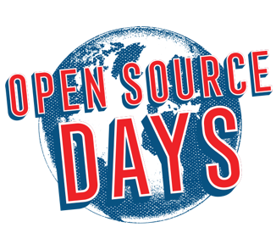
IBM Sponsorship – Premier Level
Women Of OpenStack Lunch Sponsorship
Speaking Presence
Brad Topol leading Keynote Interop Challenge Round 2 Keynote Presentation and Demo.
40-min breakout sponsored session
33 IBMers will be speaking at 22 breakout sessions, 7 Project Updates, and 4 Lightning Talks selected by community voting
Event Marketing and IBM Visibility
Medium size booth (15” W x 10’ D)
`developer-to-developer experience with hands-on labs, demos, and “Ask Me Anything” expert sessions on OpenStack topics and latest technologies .
60-sec video for monitors in the expo
Marketing slide displayed between sessions
Women of OpenStack Lunch and Mentoring session Leadership
Executive Summary
Four day conference comprised of:
Presentations, panels, workshops, and educational opportunities through OpenStack Academy.
Topics span cloud strategy and business case development to operational best practices and technical deep dives.
Keynote presentations from notable OpenStack users and industry leaders will take place on Monday and Tuesday
Open Source Days covering Kubernetes, Cloud Foundry , Ansible, Ceph, OVS, OpenContrail, OPNFV, and more.
Large Expo featuring over 100 sponsors
Expected attendance – 5000+

Slide 8
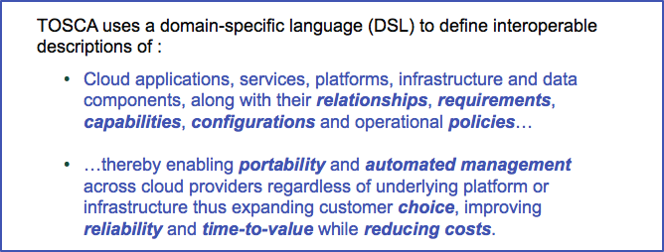
TOSCA – Topology and Orchestration Specification for Cloud Applications
An important Open standard, that is enabling a unique interoperable Cloud eco-system supported by a large and growing number of international industry leaders…
Node Types
Relationships
Capabilities
Policies
Groups
Artifacts
Custom Types
Node.js
App
ConnectedTo
HostedOn
MongoDB
Node.js
HostedOn
HostedOn
MongoDBMS
App Server
Mongo Server
TOSCA Simple Profile in YAML Version 1.0 is an approved OASIS standard
HostedOn
(TOSCA XML specification in early days, before 2013)

Slide 9


OpenStack TOSCA Parser, Heat and Heat Translator
What is TOSCA Parser?
An OpenStack project and Parser for TOSCA Simple Profile in YAML.
What is Heat?
Heat is an OpenStack orchestration engine that automates launching multiple composite cloud applications.
What is Heat Translator?
An OpenStack project to map and translate non-Heat (e.g. TOSCA) templates to Heat Orchestration Template (HOT).
Heat-Translator
Map
Generate
Heat Orchestration Template
(HOT)
Validation
Tests
Deploy
TOSCA-Parser
TOSCA Types
TOSCA Nodes
Validation
Tests

Slide 10
TOSCA to Heat Orchestration Template (HOT)
TOSCA
HOT
Note: constraint based TOSCA host and os selection vs Heat’s flavor and image values

Slide 11
TOSCA OpenStack Integration

Slide 12
TOSCA Ecosystem

Slide 13
INDIGO DataCloud and IBM Collaboration
Started via emails between Ricardo Rocha (CERN) and Sahdev Zala in 3Q 2015.
Matured after the OpenStack Tokyo Summit October 2015 with initial stakeholders Ricardo, Sahdev, Brad Topol and Matt Rutkowski.
Development contribution started by INDIGO team right after the OpenStack Tokyo Summit.
Helping and reviewing INDIGO commits were high priority for me as PTL of TOSCA projects.
Austin and Barcelona Summit joint sessions.
Paper submission co-authored by INDIGO team members and IBM.
Made OpenStack Better.
Added value to INDIGO.

Slide 14
INDIGO Contribution: TOSCA OpenStack Integration
Core reviewers in Heat Translator and TOSCA Parser
#2 committer in TOSCA Parser with 39 commits
#3 committer in Heat Translator with more than 20 commits
Improved both projects with new requirements and reporting new bugs
UPV (Miguel Caballer) has reported and worked on more than 30 bugs/features enhancements in the TOSCA Parser during the last three OpenStack release cycles.
CSIC (Alvaro Lopez Garcia) provided support for Keystone authentication and built-in Python parsing support for command line arguments in Heat Translator.
CERN (Mathieu Velten) has reported and worked on more than 20 bugs/features in the Heat Translator during the last three OpenStack release cycle. Ansible support in Heat Translator.
Source http://stackalytics.com/

Slide 15
IBM Contribution: TOSCA OpenStack Integration
Founded OpenStack Heat Translator and TOSCA Parser projects
Both are projects under main Heat orchestration program
IBM ranked #1 contributor to Heat Translator
More than 750 reviews, 225 commits and 35,000 LOC
IBM ranked #1 contributor to TOSCA Parser
More than 330 reviews, 95 commits and 16,000 LOC
Provided overall leadership and project management for almost 3 years
Source http://stackalytics.com/

Slide 16
How INDIGO DataCloud Leverages TOSCA?
INDIGO creates new custom types covering it’s various use cases
Extends the TOSCA Simple Profile in YAML
https://github.com/indigo-dc/tosca-types
Some examples:
Apache Mesos cluster deployment (infrastructure)
Elastic cluster for batch processing (infrastructure)
Supported systems: Slurm (official), Torque, HTCondor
Galaxy portal (end user)
Data intensive application for biomedical research
INDIGO Datacloud specific jobs (infrastructure / end user)
Package and deploy applications in Docker containers, on Mesos/Marathon/Chronos

Slide 17
OpenStack Summit Fun Facts
OpenStack summit in last three – four years
Attended by over 5000 participants (~7000 in Austin 2017)
Represented by over 700 companies (936 in Barcelona 2017)
From over 60 countries (69 in Barcelona summit 2017)
Hundreds of sessions with triple the submissions (500+ in Barcelona)
Having session accepted at the summit is a BIG thing

Slide 18
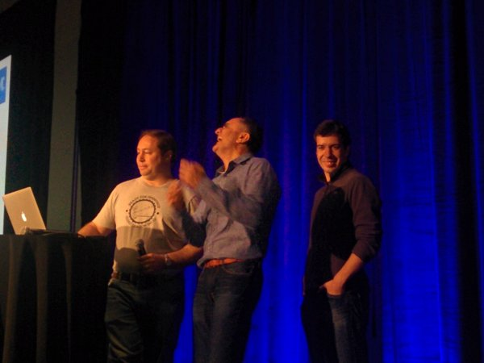
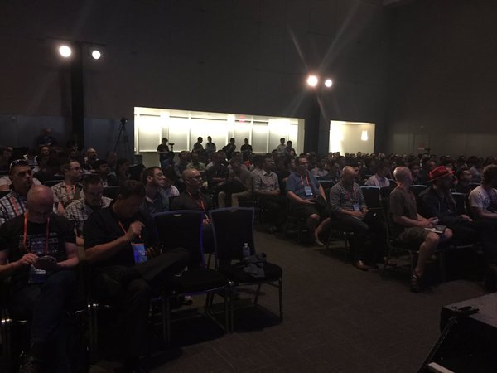
OpenStack Austin Summit March 2017 Speaking Session
Title: CERN and Science Clouds in Europe with TOSCA, OpenStack Heat and the Heat Translator
Speakers:
Ricardo Rocha and Mathieu Velten (CERN), Sahdev Zala, Matt Rutkowski and Brad Topol (IBM)
Great crowd. We demonstrated a basic use case. Updates on the TOSCA projects.
URL: https://www.openstack.org/videos/video/cern-and-science-clouds-in-europe-with-tosca-openstack-heat-and-the-heat-translator

Slide 19
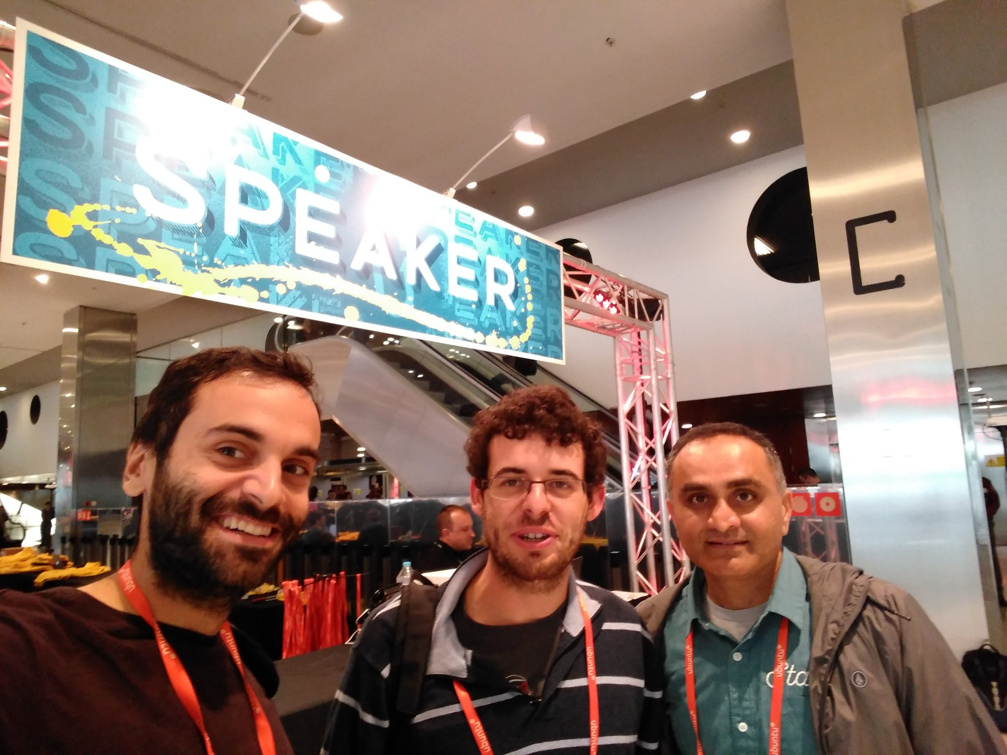
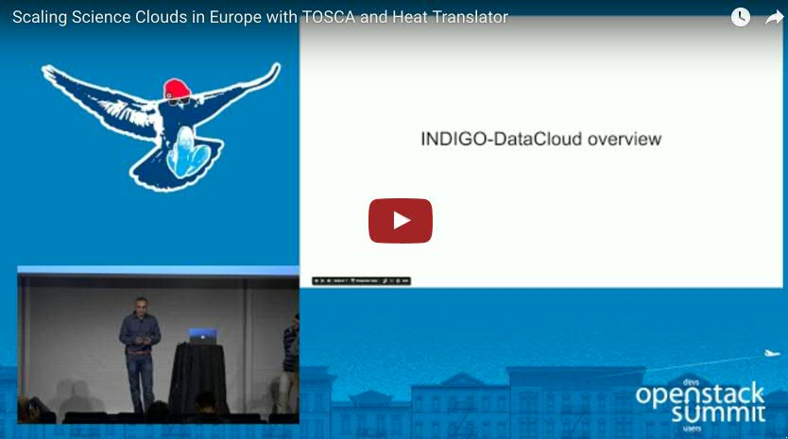
OpenStack Barcelona Summit Oct 2017 Speaking Session
Title: Scaling Science Clouds in Europe with TOSCA and Heat Translator
Speakers:
Álvaro López García (CSIC), Matheiu Velten (CERN), Miguel Caballer (UPV), Sahdev Zala (IBM)
Showcased INDIGO team contribution with advance usage. Updates on the TOSCA projects.
URL: https://www.openstack.org/videos/barcelona-2016/scaling-science-clouds-in-europe-with-tosca-and-heat-translator

Slide 20
Journal of Grid Computing Paper
Submitted paper on the work titled, Orchestrating complex application architectures in heterogeneous clouds
Authors:
Miguel Caballer, PhD (UPV)
Sahdev Zala, MSc (IBM)
Alvaro Lopez Garcia, PhD (CSIC)
Germán Moltó, PhD (UPV)
Pablo Orviz Fernandez, MSc (CSIC)
Mathieu Velten, MSc (CERN)

Slide 21
IBM Open Source Commitment

Slide 22
IBM has a long history of leading innovation with open technology

Slide 23
IBM Cloud Platform – Open By Design
Check out IBM Bluemix ibm.com/bluemix
The Bluemix cloud platform is not just about creating new apps or migrating existing ones, on-prem or off-prem implementations, or offering IaaS and PaaS cloud services. It's designed to bring all of these aspects together to help you solve your real, complex business problems in the cloud.

Slide 24
Learning Resources
INDIGO DataCloud https://www.indigo-datacloud.eu/
OpenStack https://www.openstack.org/
OASIS TOSCA
https://www.oasis-open.org/committees/tc_home.php?wg_abbrev=tosca
TOSCA Parser
https://github.com/openstack/tosca-parser
https://pypi.python.org/pypi/tosca-parser
Heat Translator
https://github.com/openstack/heat-translator
https://pypi.python.org/pypi/heat-translator
IBM Bluemix ibm.com/bluemix

Slide 25
Thank you
EGI, INDIGO team and all the contributors of the OpenStack Heat Translator and TOSCA Parser
Prof. Jesus Marco de Lucas
CSIC
Dr. Tiziana Ferrari
EGI
Dr. Davide Salomoni
INFN
Alvaro Lopez Garcia
CSIC
Miguel Caballer
UPV
Mathieu Velten
CERN
Ricardo Rocha
CERN

